Slide 1

MOVIE COLLECTOR: POPCORN

Slide 2




Project team members
Sytiva
Alana
Sonny
Pengxu

Slide 3

Project Definition
Popcorn is a web application that will allow users to browse through various genres of movies extracted from the IMDB API database.
Popcorn will allow users to find the movie they want to watch and which platform it is located on instead of switching between the different apps to browse allover again in the movie section.

Slide 4
The goal
Popcorn offers the convenience of having all movies located in one website with links to the platforms the movie is located on.
The goal is to have a web application with all movies listed and users able to get proper recommendations from previous movies they have watched, favorited or based on their specific preferences along with which movie streaming service they use.

Slide 5
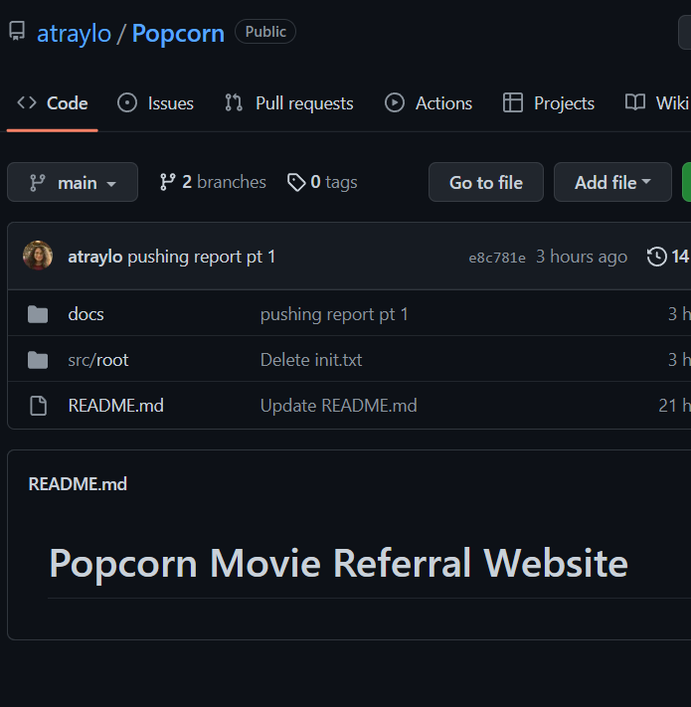
how will it be achieved
Communication:
Discord
Platform:
PC
mobile
Coding:
Visual studio
GitHub

Slide 6
Project Requirements
user-friendly
creating an account
picking a few genre preferences
Recommendation System
Search server
All-platform support
All internet browser
All hardware machines supports internet browser
security
Microsoft Azure

Slide 7
Project Specification
Front end
CSS
html
Back end
PHP
Html
Python
Microsoft Azure
sparkSQL

Slide 8
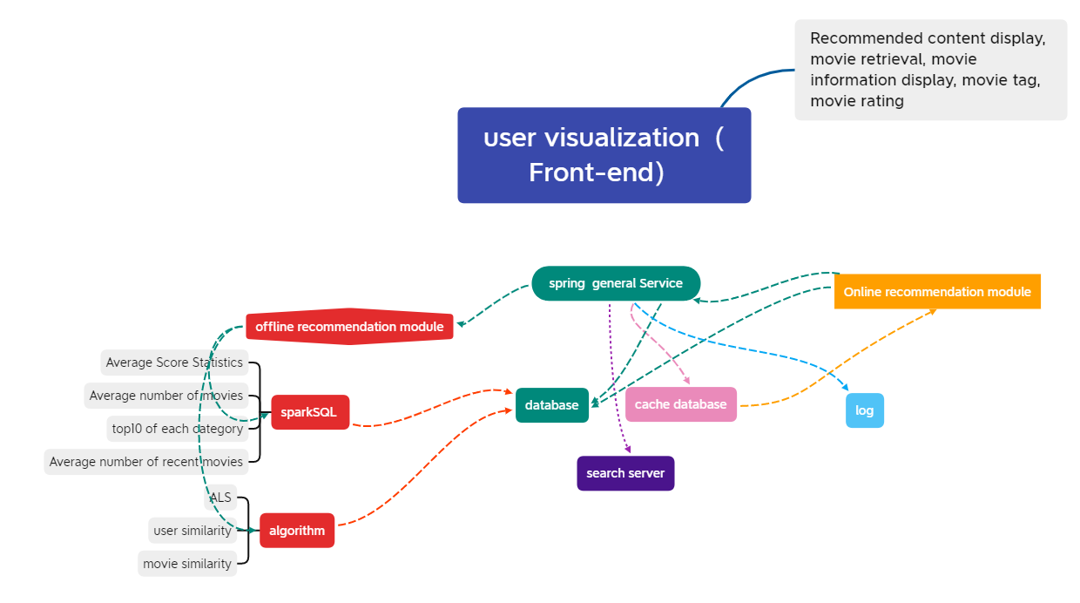

Slide 9
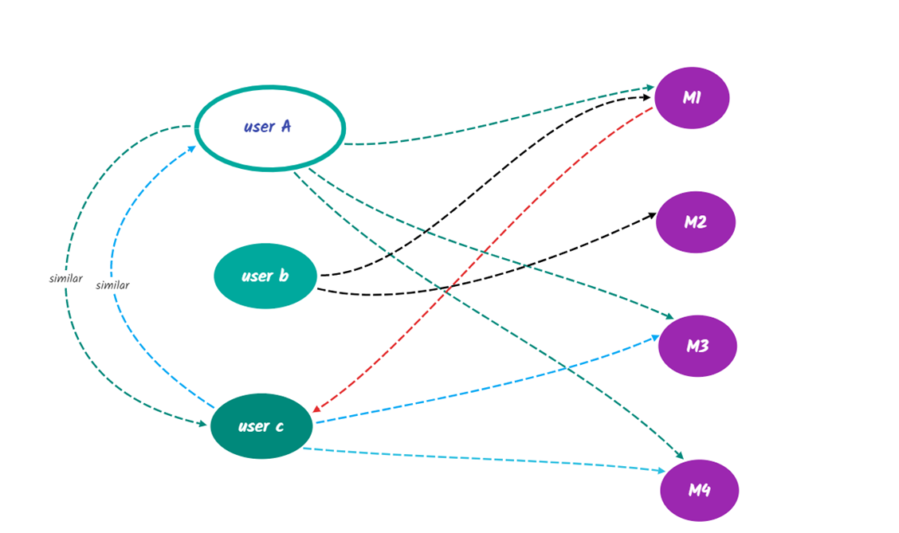
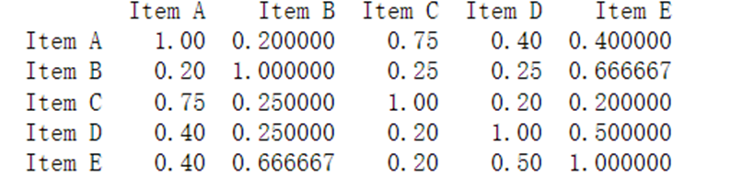
Recommendation System Design
Popularity-Based Recommendations: Box Office Charts
Recommendation based on collaborative filtering: find users with similar histories and see what movies to watch again
item-based CF

Slide 10
Thank you

